Slide 1
Correlation of World GDP and Human Development Indexes
With a twist of Corruption index analysis…
Adriana Avalos
Levi Rodríguez
Luis Goldaracena
Matheus Gratz

Slide 2
“
Nowadays there is a lot of data about global economic growth by nations and the wellbeing of their habitants.
Therefore, a natural question is how do economic growth impact on wellbeing.
In cases where no correlation can be obtained between these two factors, we can look for other indexes (such as Corruption Index) that might help us to understand this kind of behavior.
“
Does economic growth impact on wellbeing?

Slide 3
Agenda
01
High Level Process
02
World Bank Database
03
Human Development Database
04
World Corruption Index
05
Results and Findings

Slide 4
High Level Process
How we have set a step-by-step process to tackle the data and get some questions answered.
1
3
Identify and Assemble
Clean and Transform
Observe Limitations
Get the answer!
Obtain the information by identifying the data sources, assembling the data
Clean the data and transform it based on our strategy and metrics
Acknowledge database limitations, and trace a strategy to consider them
Look for trends and get the questions answered
2
4

Slide 5

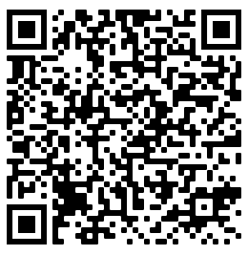
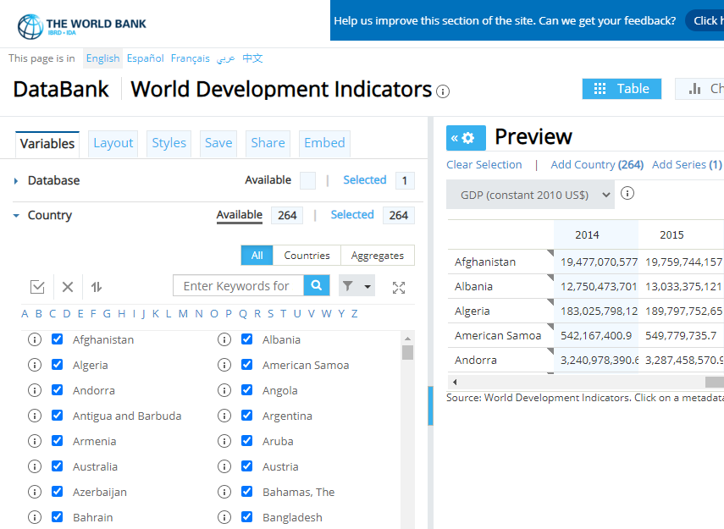
Do a quick scan to view the Jupyter Notebook for World Band Db
The World Bank website have 78 indicators for 264 nations around the world. Those indicators can be as simple as GDP – Gross Domestic Product, or complex such as Health nutrition and Population Statistics.
The website has a tool which you can design you own report and export to CSV and other formats.
In our case, we designed a report to extract the historical GDP from all available nations, from 1990 to 2017, and exported it to a CSV file.

Slide 6

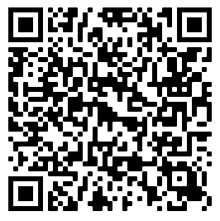
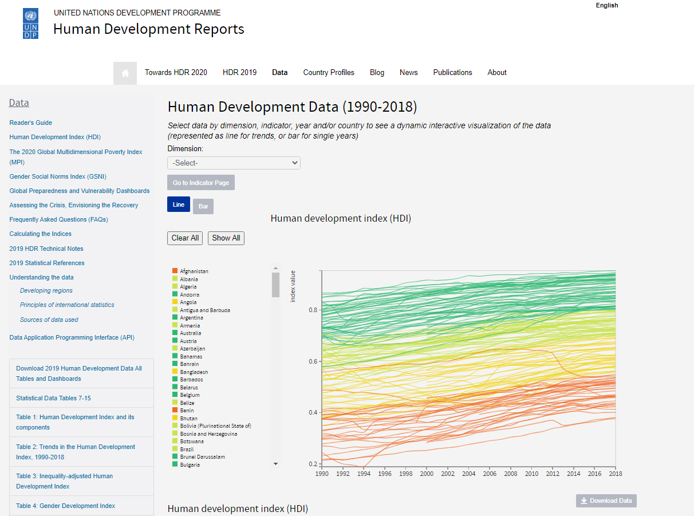
Do a quick scan to view the Jupyter Notebook for HDEV Db
The United Nations development Programme for Human Development Reports has thousand of indicators.
Examples:
HDI: Human development index (HDIg)
Internet users (% of population)
GII: Gender Inequality Index
Mobile phone subscriptions (per 100 people)
In our case, set an API request to extract almost 1million records from the HDEV website, and transform them directly in python using pandas!

Slide 7

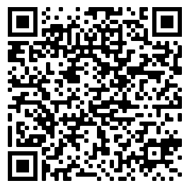
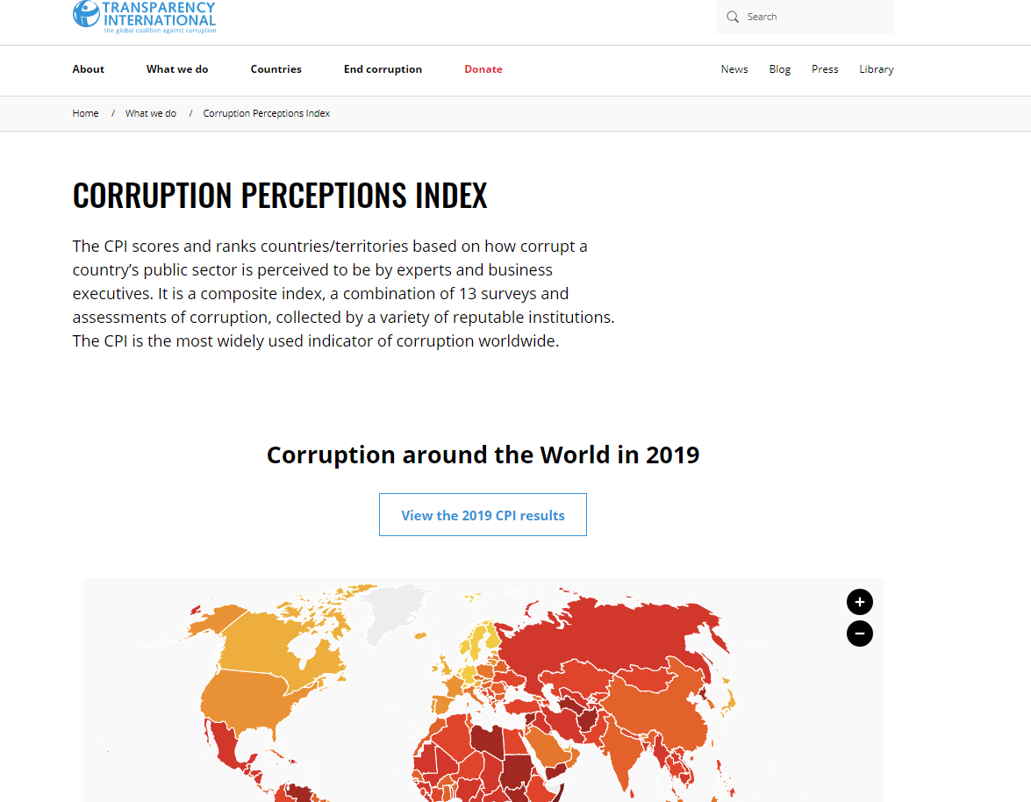
Do a quick scan to view the Jupyter Notebook for Corruption Index
The CPI scores and ranks countries/territories based on how corrupt a country’s public sector is perceived to be by experts and business executives.
It is a composite index, a combination of 13 surveys and assessments of corruption, collected by a variety of reputable institutions.
In our case, the Transparency website has the database already in CSV, we loaded it in python using pandas!

Slide 8
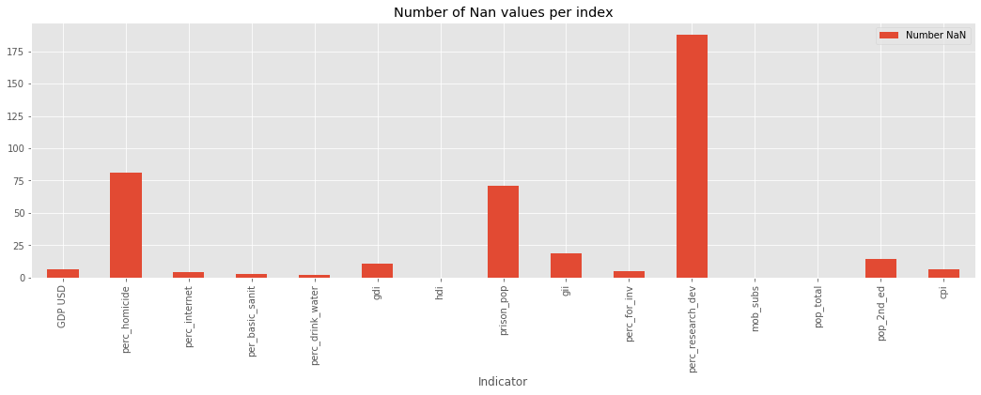
Results and Findings
Some HDEV indexes are not measured in some countries…

Slide 9
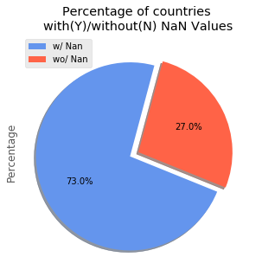
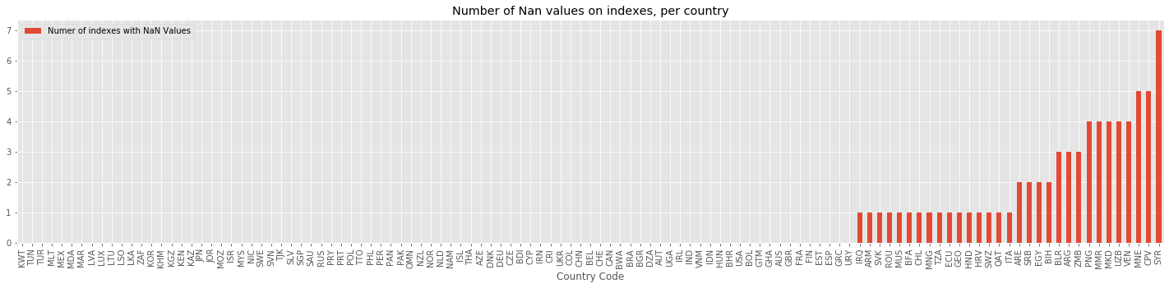
Results and Findings
And these countries are…
'IRQ', 'ARM', 'SVK', 'ROU', 'MUS', 'BFA', 'CHL', 'MNG', 'TZA', 'ECU', 'GEO', 'HND', 'HRV', 'SWZ', 'QAT', 'ITA', 'ARE', 'SRB', 'EGY', 'BIH', 'BLR', 'ARG', 'ZMB', 'PNG', 'MMR', 'MKD', 'UZB', 'VEN', 'MNE', 'CPV', 'SYR'

Slide 10

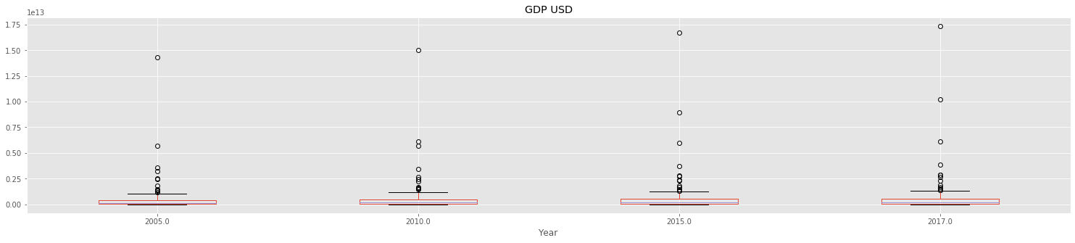

Results and Findings
The world in numbers: GDP by country. Is there any country that can be considered an outlier?
The United States and China are so big that they can be considered outliers among the 172 nations observed.
Look how China has been growing through the years!

Slide 11
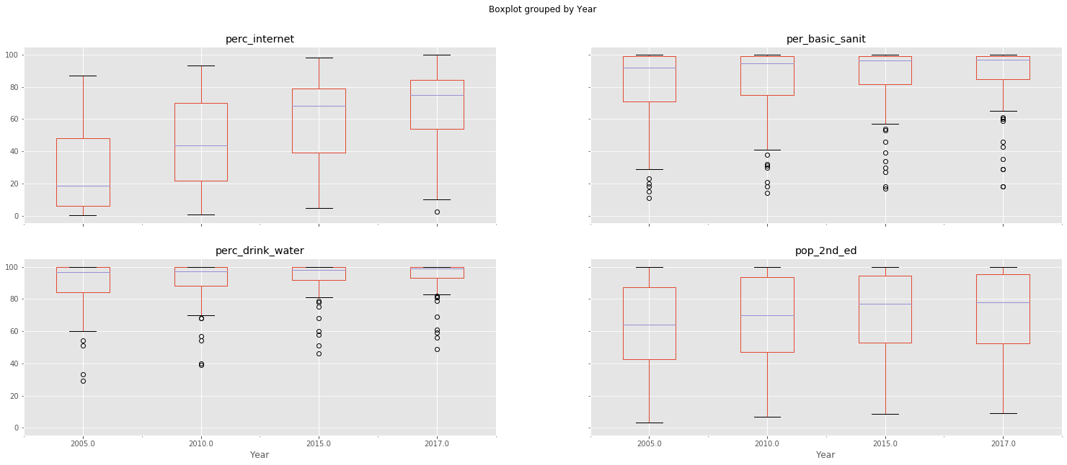
Results and Findings
The % of internet access is pretty much homogeneous around the world.
However, some countries still do not have basic sanitary and drink water access.
The world in numbers: other indicators (Measured by %)

Slide 12
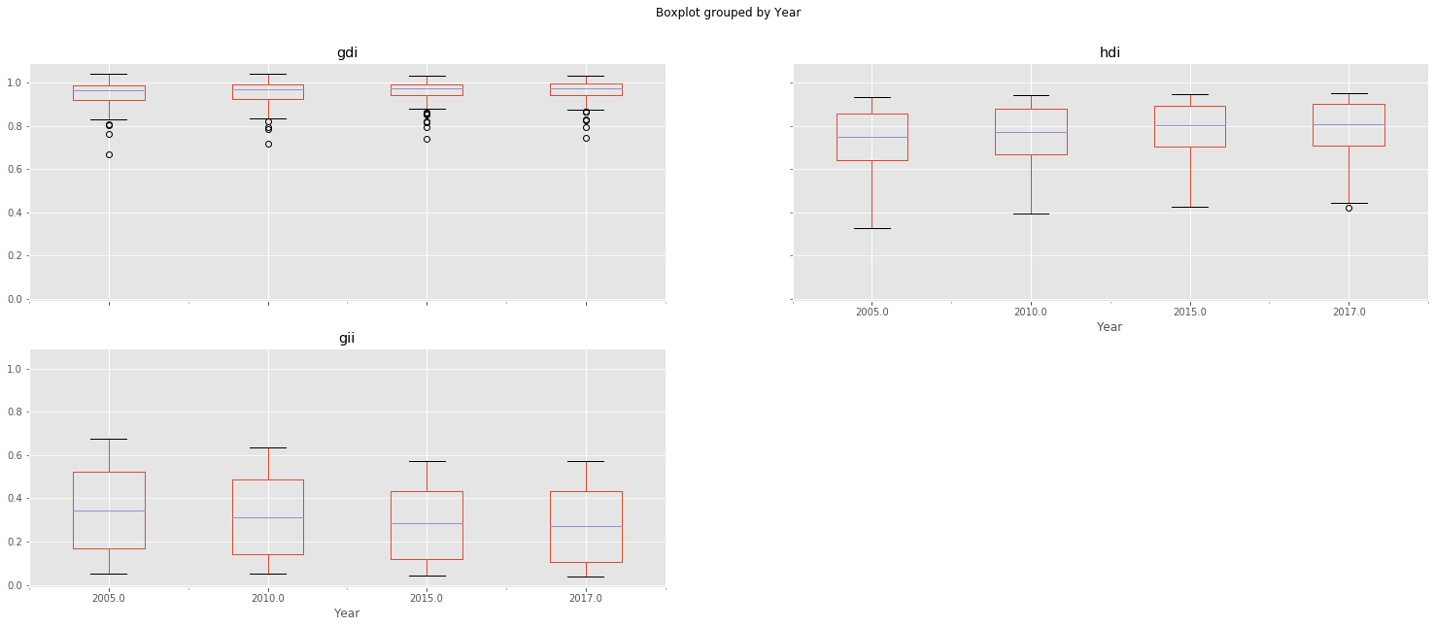
Results and Findings
The world in numbers: other indicators (Measured by Index)
The index that measures GDI/GII (Gender Development Index) has some outliers, showing that some countries has not been investing on gender equality.

Slide 13
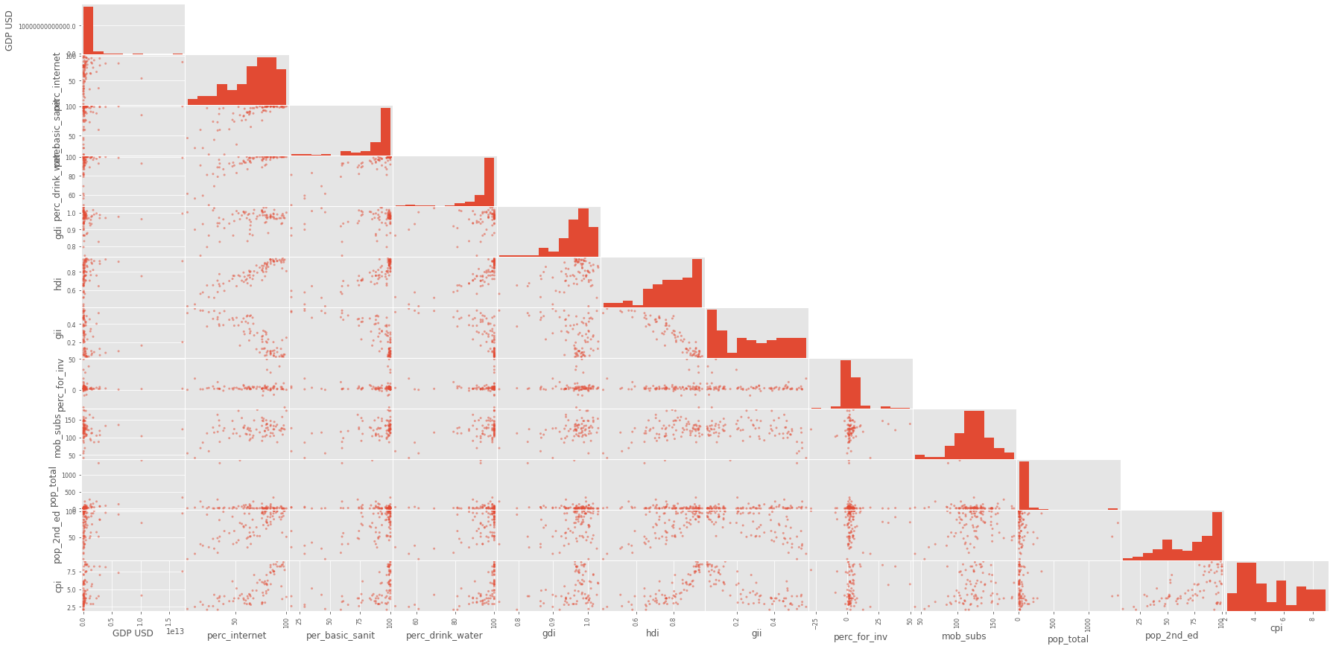
Results and Findings
The world in numbers: matrix of indexes correlations
We can see that some indexes are directly correlated, such as ‘Population with 2nd grade education’ and the HDI (Human development Index) – box (1).
Others there no correlation at all, such the GDP with all other indexes.
So, if a country has a HUGE! GDP it doesn’t mean that it is developed from the wellbeing standpoint.
1

Slide 14
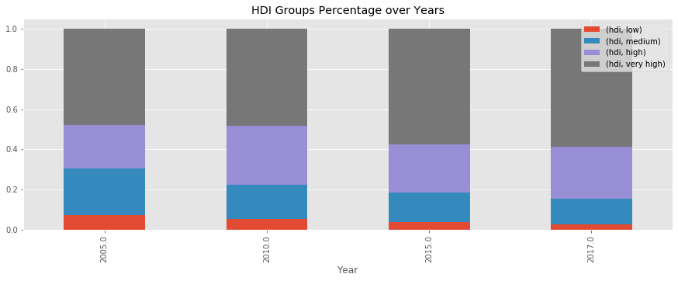
Results and Findings
The world in numbers: HDI – by category, how some countries are growing on that specific index?
Over the years, the number of countries with LOW HGI are reducing.
On other hand, countries with HIGH HDI are also reducing, but the MEDIUM ones are increasing from 2005-2017.

Slide 15
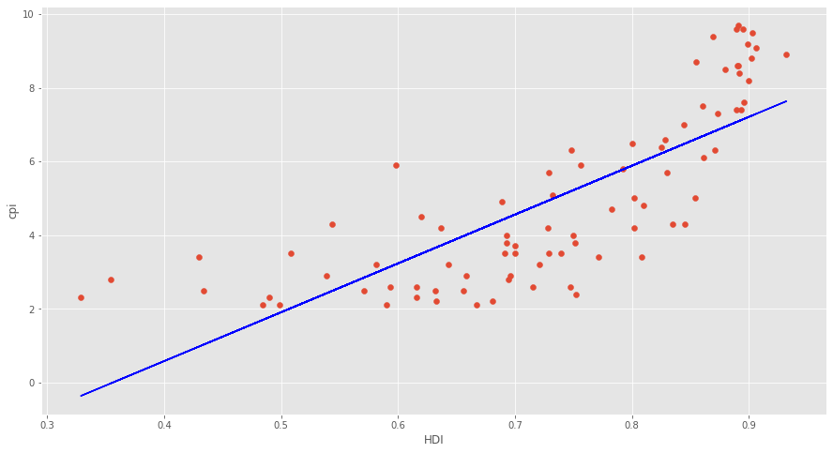
Results and Findings
The world in numbers: HDI vs. CPI. Does Corruption impacts on Human Development Index?
Corruption vs. Human Development Correlation
The answer is YES!
Most corrupted countries has a high impact on HDI, which means that the income is not invested on it should be invested.
r-squared: 0.6083 Equation: y = 13.27x + -4.73

Slide 16
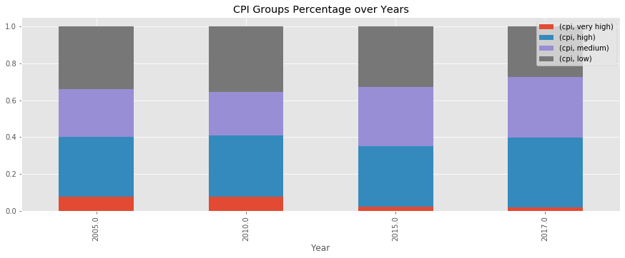
Results and Findings
The world in numbers: How corruption in growing along the time…
Both VERY HIGH corrupted countries and LOW corrupted countries are decreasing along the time.
Which means that, on average, every country has a good amount of corruption.

Slide 17
Thank you

